Slide 1


Learning Meets Networks: Challenges and Opportunities
Xin Liu
Computer Science Department
University of California, Davis

Slide 5
A Little Bit about Myself
B.S, M.S., Xi’an Jiaotong University
Ph.D., Dept. of EE, Purdue University
Post-doc, UIUC
Professor, CS, UC Davis
MSRA, 2012- 2014
Cellular resource management
Cognitive radio networks
User-Profile-Driven mobile resource management
Data-driven approaches in networking

Slide 6
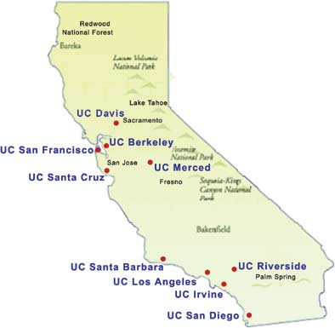
A Little Bit about UC Davis
Established in 1905
About 30,000 students
Agriculture #5
Engineering #31
CS #33
30km to Sacramento
100km to San Francisco
150km to Silicon Valley

Slide 7
Outline
Challenges and Opportunities
Case Studies
Application-driven studies
Theoretical studies
When and How

Slide 8
Challenges and Opportunities
Notes:
Let me tell you a little bit about my background. My research has been in computer networks, in particular, wireless networks, for 10_ years since my PhD study. In the past few years, we have slowly and steadily moved into the intersection of machine learning and computer networks, focusing on learning-aided resource allocation in computer networks. We have studied both more practical problems raised by network operators, as well as more theoretical problems abstracted from the practical study. We publish in both networking venues such as IPSN and JSAC, as well as ML venues, such as NIPS and KDD.
In this talk, I will discuss some challenges and opportunities that I observe in the intersection of learning and networks. Clearly, this will not be comprehensive. More important, I have far more question than answers. The goal of the talk is to stimulate discussions and encourage collaborations.

Slide 9

Who Cares?
Wide applications
Challenges
Advances
Notes:
Whenever we work on a research problem, we should ask the question of “who cares”. Ideally, we should not publish just for the purpose of publishing. 简单来说，自娱自乐不是，也不应该是我们的目标。So I am going to talk about who should care about this line of research. Roughly speaking, I can see wide application scenarios of ML in networks. We also face some challenges, some common to ML field and some more unique to networking. Given these challenges, we can make advances not only in solving Newtowrking problems, but also has the potential of advancing ML researches. I will give examples on both in this talk.

Slide 10
Learning Meets Networks
Anomaly and intrusion detection
Flow classification
Traffic prediction
Congestion control
User profiling
Fault diagnosis
Routing
Modulation classification
User profiling
… …
Notes:
Like in many other fields, machine learning techniques have started to make an increasing impact in computer networks. Many aspects have been touched in this process. A few examples are listed here. For example, in computer networks, there are many different types of flows. One example is elephant flow vs. mice flow; i.e, very large flow vs. small flow. ML-based flow classifications can help for say, better load-balancing.
http://networkml.github.io/program.html
http://packetpushers.net/machine-learning-for-networks/
Traffic prediction: ML techniques have been used to predict traffic and seasonality. It could predict when there will be peak traffic (for example on a Monday morning) and dynamically anticipate congestion and take proactive measure to divert traffic onto an alternate path. We have done some work along this line for 360-degree videos.
User profiing, ML techniques have been used to generate user profile, which can be used for better traffic engineering, say content delivery and content prefetching. We have done some work along this line for mobile social content prefetching.
Congestion control from the edge has been a productive research area since the seminal work of the 1980s, the creation of TCP. End-to-end algorithms typically compute a congestion window or a paced transmission rate. Learing-based congestion control algorithms have been proposed and show promising results.
Security: Threats are evolving all the time and while our traditional signature-based security approach is to look for known vulnerabilities, we should instead look for anomalous behaviors we have not come across before. We need machines to create a model of the ‘normal’ and detect outliers through machine-learning.
Change success prediction: This ACL/Routing/QoS change will cause event <X> with probability P
Fault diagnosis: Self-Learning Network could potentially identify misbehaving networking devices (caused by software defects and hardware faults) that could not be identified with traditional tools.
Routing is one of the most critical components of the internet. Learning-based routing algorithms have been shown
These are just a few examples of how in gneeral learning can benefit network management, resource allocation, and control.

Slide 11

Challenges and Opportunities
Notes:
IN such cases, ML or learning techniques can be used strictly out of the box, like some of the examples I gave earlier. However, as a field, leanring has yet to unleash its full potential in networking. Therefore, a large number of opportuniteis exist. So challenges co-exist. Some challenges are fundamental challenges that are being studied in the field of learning themselves. Some needs adapatations. Others are somewhat unique in networking. We will discuss some of the challenges as follow. Of course, this is not a complete list.

Slide 12
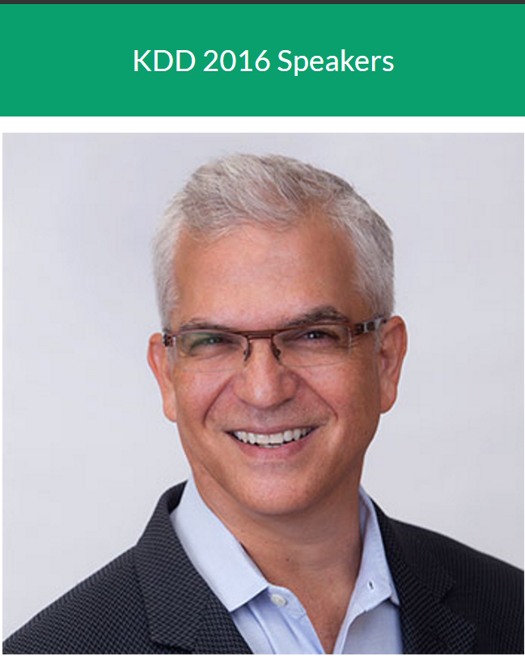
A VC’s Viewpoint
Analytics
Predictive
Decisive
Greg Papadopoulos of NEA
Notes:
NEA Partner Greg Papadopoulos—NEA Partner Greg Papadopoulos

Slide 13
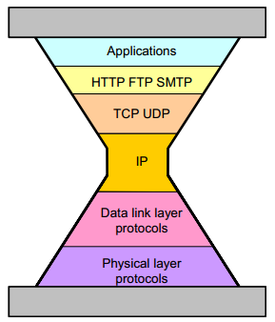
Network is Complex
Multiple layers
Different players
Diverse time scale
Distributed
Notes:
today’s networks are highly complex, include multiple layers and various players operating at different time scales. A network consists of physical layer, media access layer, network layer, transport layer, and application layer. The network architecture is often shown as a thin-waist hourglass protocol stack.
Roughly speaking, the thin-waist is the Internet protocol that controls the routes for packet flows.
Above the thin waist is the visible upper (application software) and below lower (hardware) layers. Just to bring everyone to the same page, let me use an example in a highly simplified manner to illustrate the idea here. Consider this simple example. Say, you are bored with this talk. So you open the facebook app on your phone, a friend just shared a graduation video, you clicked on the video, started watching the video. This involves all the layers shown here. Your application software, in this case, a video player with potentially its own protocols, such as video codec it uses, pause, fast-forward, retransmission, etc. It needs to talk to the FB server using the same protocol. The FB server contains the video file, literally binary bits. They can use, say HTTP protocol, to communicate with the user. The HTTP files are then passed to TCP protocols, which does rate control, reordering and error correction. TCP segments are then passed to IP, including IP header. IP, the Internet protocol, handles routing, one of the key funcationalities of the Internet. All nodes can be connected to the Internet if they speak IP. At each node, the IP packets are further
passed in the link layer protocol, which decides who sends at what time (because there are many people sharing the wireless media). and then onto the physical layer media that decides the appropriate coding modulation schemes and transmission power, rate. You can imagine that all layers have its own control and resource allocation mechanisms. In this architecture, IP is the only protocol that is shared by all nodes in the network. All other layers, there are different protocols. Almost in all these layers and protocols, there are opportunities to use learning-based schemes to improve performance. That is huge opportunities.
Given the wide range of physical networks, the huge diversity of applications, and the vast number of Internet users, it is not unreasonable to call Internet a highly complex system. In all stacks, some kind of control, resource management mechanisms are implemented, aware or unaware of the control mechanisms in other layers.
Application software generate application specific protocols, e.g., videos, facebook application, games. They select appropriate application-layer protocols for broad interpretations. For example, video files are often transmitted using HTTP protocol, which can be interpreted by all web browsers. Then TCP controls their rates and guarantees delivery. This allows “plug-and-play” between modules that obey shared protocols; any set of applications that “talks” TCP can run transparently and robustly on any set of hardware that “talks” IP.
Furthermore, there are different types of players in the network, all of them significantly affect the network performance and user experience. Roughly speaking, the key players are including network operator, content provider, application software, and human user. Consider this simple example of watching a video online. the video stopped. What happened? All The key players will affect your experience. The network operator is the entity that provide the physical connections between your phone and the facebook server. Note that multiple operators can exist here. If any of the links do not have enough bandwidth for your video. Your video can halt. Furthermore, the halt could do do the insufficient capability of the Facebook server, in this case, serving as content provider. In addition, it is also possible due to bugs or configurations of the application software. Last, it could also be that you click on the pause sign intentionally or unintentionally. All these players implement control mechanisms for the purpose of improving user experience and controlling cost. These mechanisms may or may not be aware of each other.
I kind of gloss over many details, such as content delivery network operators.
As I said, likely different resource management and control mechanisms are implemented in all layers, by all players. We need to note that they are also implemented at very different time scales. For example, physical layer resource allocation and scheduling, coding, modulation, rate adaptation typically happens in small scale, millisecond or submillisecond, depending on the physical media and speed of the link. User arrival and departure happen in subsecond, seconds or minutes. We note that users here are anything that generate traffic, they are not only human users, but also machines, as well as the Internet of Things. Network configuration in hours or days, to network planning in months or years.
Last, it might already be obvious to some, the system is highly distributed. Billions of Internet users, millions of autonomous networks, being connected together, millions of applications, hundreds of thousands of content providers, thousands of network operators, they belong to different entities, locate overall the world. This is a highly distributed system.
Because of these factors, Such a network, or even one specific task, such as improving video viewing experience, can be highly complex and typically beyond the capability of white-box modeling. Therefore, learning-based approaches are advantageous and the wide scope of network applications provides ample opportunities for performance improvement. There has been a lot of work as briefly mentioned in the earlier slide.
It is worth mentioning that the network community, including network science community, have made significant progress in the theoretical modeling and analysis of networks. For example, TCP congestion control has been well studied in both theoretical and empirical network research community. Various utility functions are proposed and analyzed and performance compared with experiments. New TCP congestion control mechanism are also proposed based on theoretical analysis. I think such analysis provides strong guidelines and domain knowledge on how to best control network resource. Their limitation is often that the more idealized assumptions may or may not hold in reality. Furthermore, their interactions with other layers, players, are much more difficult to analyze, again, coming back to the theme that networks are highly complex and beyond the capability of white box modeling. However, such insights obtained from the theoretical understanding can significantly speed up the learning and should be incorporated in learning-based approaches.
Overall,

Slide 14

Complex Interaction
Layers
Players
Time-scale
Interference
Interconnection
Notes:
Example: For example, you click on a video link that your friend just shared with you. It is slow, why? Is it the device, the application software, the network, or the content provider?
video?
At the same time, it also raises significant challenges on how control mechanisms in a complex system at different layers, users, and time scales, interact with each other. Consider again the example of watching video again. A popular video can be transcoded into different resolutions a priori and stored on the server. Which one will be transmitted depends on the bandwidth available and the viewing device, the bandwidth depends on the TCP congestion control, routing, the control and resource allocation on the link layer and physical media. A bit error at the physical layer can result in retransmission in the physical layer, coding/modulation change. It could result in packet loss and thus trigger retransmission at the TCP layer, and thus rate changes. It could result in routing changes. All these can result in the server sending a different resolution stream. Furthermore, the transmission of one user interferes with that of another user.

Slide 15
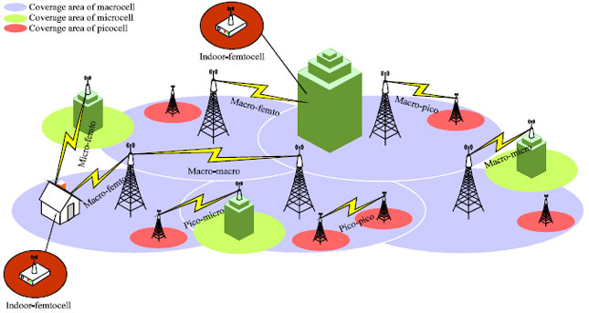
Interference

Slide 16
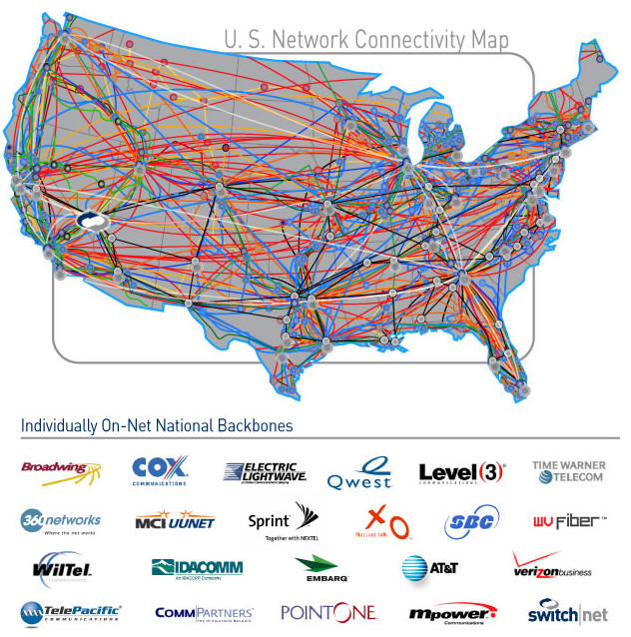
Interconnection

Slide 17
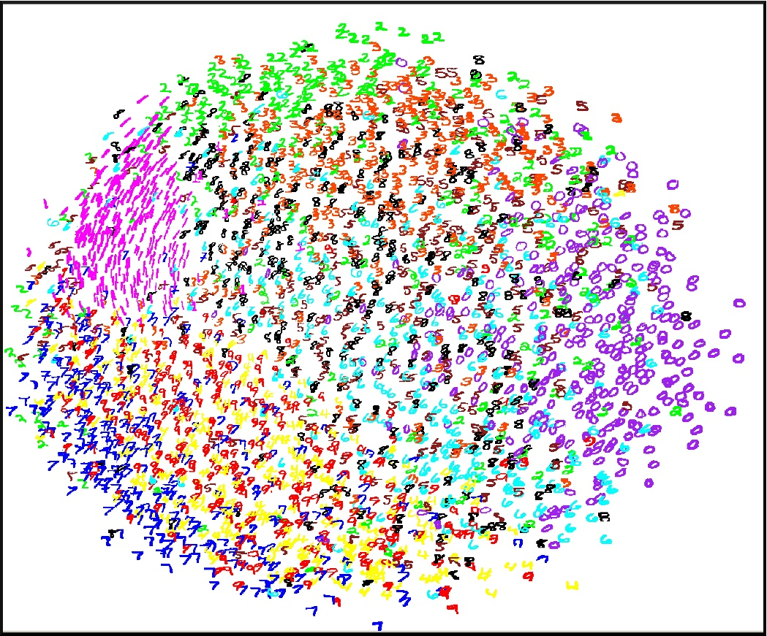
High Dimensionality
Large # of factors
Complex interaction
Application scenarios
Notes:
Because networks are highly complex, a lot of the problems we see have high dimensionality. A network node may have a large number of parameters it can control, and the problem is further compounded by the size of the network as network nodes are interconnected.
For example, a cellular base station has a few thousands of parameters that it configures. Furthermore, the configuration of one cell interferes with neighboring cells and so on. For example, increasing the transmission power of one cell improves the signal quality, and thus potentially improving the throughput and reducing delay, of the users in this cell. At the same time, it causes more interference of users in its neighboring cells. Furthermore, it changes the dynamics of user association and may trigger handoff; i.e the users at the edge of the cells may change which cell tower they connect to, and this change is handoff.
From field experience and model-based analysis, not all parameters are equally important.
This problem can be further complicated by the complex application scenario. For example, in a cell, let’s say we want to masimize the overall throughput, which is roughly proportional to the operator revenue. However, the thoughput depends on many factors,
the number of the users, the location of the user, how far as they from the base station, how much interference they observe from other cells, the mobility of the users, are they stationary, walking, driving, the type of applications that they are using, for example, a video user generates traffic that is much different from a user texting. These issues make the problem more complex.
Consider another example. a high speed router sees hundreds of thousands of flows each second from different source-destinations, for different applications. The routers are interconnected. What happens in one router affects its flows, and thus other routers what the flows pass, and so on.

Slide 18
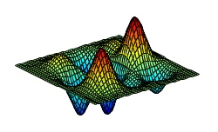

Coupled Resource Constraints
Notes:
A somewhat unique issue that I see in networks is the coupled resource constraints. For example, the total transmission power of a cell tower cannot exceed its maximum power. Such coupled resource constraints and the need for resource optimziation often result in non-convex optimization problems. Such resource constraints need to be handled appropriately to avoid an exponential increase in dimensionality. Recent advances on constrained non-convex optimization provide potentially useful techniques.

Slide 19
High Variability
User dynamics
Traffic diversity and dynamics
Mobility
Environmental differences
Diverse applications
Heterogeneous user behavior
Notes:
Make data very noisy , the right level/granuality of modeling

Slide 20
Multiple Objectives
Throughput
Delay
Fairness
Stability
Robustness
Please nothing can go wrong
How to integrate these objectives?
I know what I (do not) want it when I see it.
Notes:
Defining the reward is indeed a critical issue in real-life learning schemes. King Midas.

Slide 21

Data, Data, Data
Collect
Share
Store
Granularity
Label
Privacy
Biases
Experimentation may be difficult
Notes:
Biases: anytime you have a dataset of human decisions, you have biases, e.g., whom to hire, medical diagonosis, object identification.
Pokeman Go: less pokeman in primarily black neighborhood because developed not familiar with these neighborhood.
Linked in: highly paying jobs displayed less to female candidates.
Google: initial face regonization software often tagged black people as gorillas.

Slide 22
Interpretability and Insights
Why and how
Domain knowledge
Deeper insights
Performance & architecture
Notes:
Interpretability is a fair common issue in ML. It is probably more important in networking, both because of people’s mindset and because of its necessity.
A result is far more useful when we can interpret it and gain insights from it. This is where domain knowledge can play a big role to help us gain deeper insights. Example? Zhili Zhang’s sigcomm 2013 work on search response time. One very counterintuitive result they found is that the search response time is longer when the search load is low. How is that possible? To understand it and to explain it, the authors analy
Furthermore, in networking field, we are not only trying to improve performance. We also hope to find better network architecture. There, interpretability is also far more important.
From publication perspective, if the result is “I tried this and its performance is better”. Yah, okay. If you can say “I tried this, its performance is better, and I find out the reason is “. It is far more interesting, and far more likely to be accepted.

Slide 23
Opportunities
ML is not a cure-for-all.
All layers
Ex: AMC, MAC, routing, TCP, video bit rate control
All players
Ex: network operators, CDN operators, content providers, application software
All objectives:
Networked users (churn, fraud, etc.)
Network services (video, etc.)
Networks – both existing (e.g., TCP) and new architecture
Notes:
First, I want to make it loud and clear – ML is not a cure-for all. Example 1: we did for traffic prediction and scheduling. An industrial collaborator came to us with this problem. They want us to help predict traffic arrivals for resource scheduling purpose. It turns out that we can predict reasonally accurately, but not enough. This problem has some fundamental challenges. For example, if the traffic comes every three or four time slots, each with 50%. You can see it cannot be predicted perfectly. About 50% of the chance you will be wrong by 1 time slot. We propose to them to see if this is acceptable, measuring accuracy in a different way, one time-slot delay. They do not want to accept it. That makes the scheduling based on prediction unacceptable. So we decided not to go forward.
Another example, physical layer point-to-point communication. A lot of people have worked hard on it for decades and in many cases we are pretty close to reach Shannon capacity. I would consider this not a good candidate for ML. Well, we do not need it given there is really not much room for improvement. Of course, if the problem changes, for example, MIMO, then it might become a possible candidate.

Slide 24
Application Scenarios
All layers, all players
Model/optimize networked users (churn, fraud, etc.)
Model/optimize network services (video, etc.)
Model/optimize networks
Replace existing heuristics (e.g., TCP)
Adding new functions (…)
Software-defined networking (SDN)
Self-organizing networks
Self-learning networks
Network diagnosis, trouble shooting
Network management and planning
Cellular infrastructure
Data-center networking
Cloud service
Network performance
Notes:
Software-defined networking (SDN) is an approach to computer networking that allows network administrators to programmatically initialize, control, change, and manage network behavior dynamically via open interfaces^{[1]} and abstraction of lower-level functionality. SDN is meant to address the fact that the static architecture of traditional networks doesn't support the dynamic, scalable computing and storage needs of more modern computing environments such as data centers.

Slide 25
A High-Level View on Machine Learning
Analytics
Predictive
Decisive
Greg Papadopoulos of NEA
Notes:
NEA Partner Greg Papadopoulos—NEA Partner Greg Papadopoulos

Slide 26
Outline
Mobile prefetching based on user-profiling
Data-driven resource allocation for cellular user experience improvement
Joint learning and optimization for cellular network configuration
Prediction-based 360-video transmission
Opportunistic bandits for efficient learning
Constrained contextual bandits and dueling bandits

Slide 27
A Few Questions:
In networks, classification is often not the ultimate goal.
How can data be used for better network optimization?
How can data guide better network optimization?
How can learning and control better interact?

Slide 28
Outline
Challenges and Opportunities
Case Studies
Application-driven studies
Theoretical studies
When and How

Slide 29
Earlybird: Mobile Prefetching via Content Preference Mining and Usage Pattern Analysis
With Yichuan Wang, David Chu, Yunxin Liu
Mobihoc 2015

Slide 30
Time on Mobile
Source: Global Internet Trend, KPCB
Notes:
Based on the data from Maray Meeker’s annual global internet trend talk, we can see the significant amount of time that we spend on mobile, on average 2.8 hours/per

Slide 31
Top 10 Mobile Apps
By Usage
By # of Sessions
Source: Global Internet Trend, KPCB
Notes:
Most of the top apps are social media, including messaging. Wechat is one application that probaly everyone in this room uses a lot.

Slide 32
Mobile Social Applications
Significant amount of mobile time on social media
Usage is seeing a 63% year to year growth
Has become the primary source for news consumption
Notes:
Furtermore, we are seeing growth of social media usage. It has also become a primary source for news consumption

Slide 33
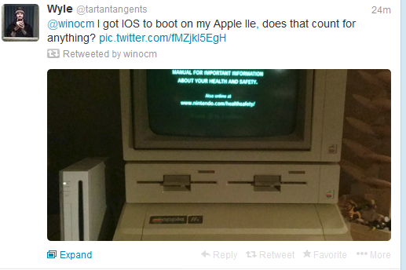

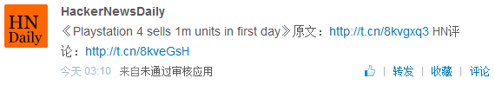
Social Media
20% of the social posts contains URL links
30% of URLs in Twitter posts (tweets) contains image or video
Notes:
A lot of social mediam post containts URL links. For eample, we see 30% of tweets contains image or video

Slide 34

Problem Statement
Loading embedded content is slow
Reported: 3s -10s+
Our experiment over 150K embedded Twitter links:
7.5s median, 16.7s average
Not including rendering time
Intermittent network connection
Gathering, elevator, public transportation
Notes:
As discussed in the key note this morning, delay is critical. We human beings are impatent. I am sure all of us have had expeirnce with very slow embedded content loading. May not be as crazy as this guy.
First, cellular network connection establishment and roundtrip times – at least 3 seconds [4] and often 10 sec- onds or more [13] – are excessive taxes to fluid and engaging social interaction, especially when users try to retrieve mul- timedia content from embedded URLs in social posts. Using a popular Android device and stable Wi-Fi connection, we crawled over 150000 links that mobile Twitter users clicked on. The average load time (not including rendering time) of a link is 16.71 seconds, and the median is 7.5 seconds.
Compounding access latencies, mobile users often “snack” on social media in gap times such as while in elevators, on public transit, and in large gatherings (e.g., conferences, par- ties, and sporting events). Such scenarios often correlate to challenging network environments with weaker signals, con- gested networks, and moving devices.

Slide 35
Prefetching
Prefetching seems to be a feasible solution
Is traditional prefetching enough?
What is unique to mobile social app?

Slide 36

Real-life Mobile Social Usage
Data collection embedded in Twidere
100,000+ downloads
User privacy protection:
Full disclosure during installation and update
Opt-in
<15% users opted-in
Notes:
To answer this question, To study the real life usage of social media on mobile devices, it is crucial to collect enough usage data from the general public. Although Twitter’s tweets are publicly avail- able, when and how users access Twitter is not. Therefore, we collected a large set of usage data from Twidere (a Twitter app with 100,000 downloads) users who agreed to provide this information to us. With the users’ consent2,

Slide 37
Trace Characteristics
6000 users
300 million tweets
71 languages
Notes:
we collect usage pattern, link click-through, and network availability.
During the installation and update, the app discloses the information collected and we collect data only if the users choose to opt in. There are less than 15% of users choose to opt in, which indicates user privacy-awareness and the effectiveness of the privacy disclosure. In addition, we only keep a hashed user ID, which is not recoverable through a one-way hash function. Last, twitter contents and social graph are publicly available information

Slide 38
Data Collected
Limited network trace
Well studied
Avoid user burn-out
Notes:
Because existing work has carefully studied the network-condition-based prefetching scheduling using fine-grained traces [27, 21], we focus our work and the corresponding data collection on the complementary com- ponents. Therefore, to limit the collection overhead and to avoid user burn out, we decide not to collect detailed net- work trace in a fine-grain manner, but only log the WiFi availability, which is a major leverage for prefetching. We note that existing traces and techniques for predicting and utilizing favorable network conditions apply here if needed when traces are available.

Slide 39
Mobile Social Usage
Users only download 40% of their Twitter content
Users only click URLs in 7% of their downloaded content

Slide 40
Mobile Social Usage
70% of the content consumed is within 1 hour of generation

Slide 41
Prefetching
Prefetching seems to be a feasible solution
Is traditional prefetching enough?
What is unique to mobile social app?
Mobile social content is unique
Time sensitivity
Strong user preference
Embedded content (URL, video, image), NOT short posts (Tweets)

Slide 42
“What” and “When”
User preferences matters
Predict user preferences
App usage pattern matters
Network condition matters
Battery consumption
Data usage

Slide 43
“What”: Social Content Prediction
For downloaded tweets:
Personalized regression-based model
For a click, consider features vector and weight:
L1-norm regularized L2-norm minimization
Model Inference: Click prediction S

Slide 44
Features
Hashtags
Mentions
Media embedded
Link position
Geo coordinates
Adult maturity rating
Retweet count
Message length
Author
Author follower
Etc.
Not considered
Content

Slide 45
Sequential Forward Feature Selection
Notes:
Balanced accuracy is a wildly used metric in the data mining community [11], defined as the average of sensitivity (the percentage of correctly predicted tweets that are clicked), and specificity (the percentage of correctly predicted tweets that are not clicked).

Slide 46
Click-through Prediction

Slide 47
“When”: Schedule Prefetching
On-Launch Prefetching
Timely but costly
Threshold based on budget
Opportunistic Prefetching (WiFi)
Inexpensive but less accurate
App access pattern
Budget constraints by users
Battery
Cellular data usage
Tuning threshold based on budget constraints

Slide 48
“When”: Schedule Prefetching

Slide 49
Performance Snapshot
Under budget constraints
- 62% delay reduction (average)
+ 3% battery, + 40 MB per month
+ 6% battery, no additional data

Slide 50
Performance

Slide 51
Under different threshold

Slide 52
Summary
How can data be used for better network optimization?
Improve user delay experience
Collected real life user traces
Unique features of mobile social applications
User preference, user behavior pattern, dynamic network condition
Scheduling algorithms based on user specific budget constraint
When and What
Notes:
Mobile users are consuming increasingly large amount of embedded content through social applications. Social con- tent prefetching is a promising technique for improving user
experience on mobile devices. By identifying the unique features of mobile social applications, we propose a unified mobile social prefetching framework, Earlybird, that jointly optimizes the what and when in prefetching, leveraging con- tent preference, user behavior pattern, and dynamic net- work conditions. The proposed scheme can adapt to user- specific budget constraints in terms of (extra) energy and cellular data, with the objective of maximizing delay reduc- tion. We use a data-driven approach to develop personalized content model and control variables (prefetching thresholds) to achieve this goal. Evaluation using real-life Twitter traces show promising performance of Earlybird.
In addition to EarlyBird’s immediate utility for Twitter users, we speculate that our approach of unifying social and network access patterns can be generalized to other social networks as well. Furthermore, as video clips become in- creasingly popular in social mobile applications, e.g., Vine and Instagram, mobile social content prefetching will place an increasing role to improve user experience. In addition, such techniques also appear promising for a number of other problems, for example: recommendation and advertisement delivery systems, reducing the traffic of cellular infrastruc- ture, and alleviating the congestion of cellular networks.

Slide 53
Lessons Learned
Data collection could be challenging
Existing data often is not what we want.
Publishing an app is a hit-and-miss process.
Human beings are (in general) predictable
A lot of potential on personalization (on mobile devices)
Data-driven approach in networking
In addition to learning, resource allocation plays a key role.

Slide 54
Learning-based Resource Allocation for User Experience Improvement
Joint work with Y. Bao and H. Wu
KDD 2016, JSAC 2017

Slide 55

Use Case
A tier-1 operator
In a city covering 4M users, 600 complaints per day
KPI: # of complaining phone calls
Ref: From Prediction to Action: A Closed-Loop Approach for Data-Guided Network Resource Allocation, Yanan Bao, Huasen Wu, and Xin Liu, KDD, 2016
Notes:
Our work is motivated by a discussion with a cellular provider. The operator has about 4M subscribers in a city, and receives about 600 data-network related complaints per day. Their KPI is # of ..
The question was, is there anything one can do regarding the number of user complains in its network? Basically,

Slide 56
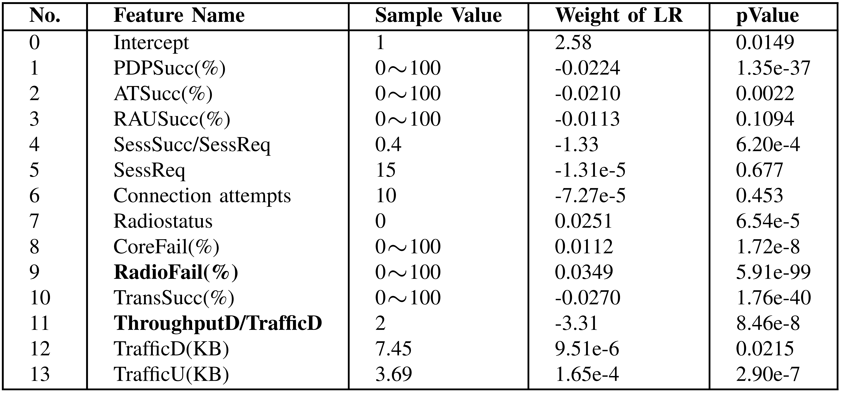
Network Performance Indicators
Notes:
The dataset contains 1275 positives, a user is considered a positive if the user makes a complaining phonecall in the hour. We have a lot more negative users, these are the users who do not make a complaint during an hour. For each user, the dataset contains users’ network performnace indicators, measured at radio network controllers. The metrics are shown in the table. There are basically 13 independent performance metrics, including metrics from radio front end, radio access network, and core networks, and traffic characteristics.
Collected at radio network contollers (RNCs)
PDP: Packet data protocol
PDPSucc(\%), PDP activation success ratio (PDP success)/(PDP Attempt) Attsucc(\%) 100 Attachment success ratio (ATTACH_success)/(ATTACH_Attempt) RAUSucc(\%) 100 Routing Area Update success ratio (RAU_success)/(RAU_Attempt) SessSucc 15 number of sucessful sessions SessReq 15 number of requested sessions attempt 2 TCP connection attempts a subset of attempts are lost due to core failure and radio failure Radiostatus 0 number of line drops before the normal line ends CoreFail(\%) 100 Core network failure ratio core network failures/TCP attemps RadioFail(\%) 100 Raido network failure ratio radio network failures/TCP attemps TransSucc(\%) 100 Data tranmission success ratio (size_dl-size_retrans_dl）/(size_dl+size_lost_dl) *100%

Slide 57
Feature No. | Feature Name | Explanation | Column1
1 | PDPSucc(\%) | PDP activation success ratio | (PDP success)/(PDP Attempt)
2 | Attsucc(\%) | Attachment success ratio | (ATTACH_success)/(ATTACH_Attempt)
3 | RAUSucc(\%) | Routing Area Update success ratio | (RAU_success)/(RAU_Attempt)
4 | SessSucc | number of sucessful sessions
5 | SessReq | number of requested sessions
6 | attempt | TCP connection attempts | a subset of attempts are lost due to core failure and radio failure
7 | Radiostatus | number of line drops before the normal line ends
8 | CoreFail(\%) | Core network failure ratio | core network failures/TCP attemps
9 | RadioFail(\%) | Raido network failure ratio | radio network failures/TCP attemps
10 | TransSucc(\%) | Data tranmission success ratio | (size_dl-size_retrans_dl）/(size_dl+size_lost_dl) *100%
11 | ThroughputD | downlink throughput
12 | TrafficD(KB) | downlink traffic
13 | TrafficU(KB) | uplink traffic
 | The two features we changed are radioFail and ThroughputD. Basically, we reduce the radio network failures by active reconnections. Then radioFail is reduced correspondingly. However, radioFail has to be >=0.
 | Downlink throughput is increased by given more bandwidth. We don't consider channel conditions in this work, and one reason is that we don't know the channel condition here.
 | All the features are averaged/accumulated values measured hour by hour

Slide 58
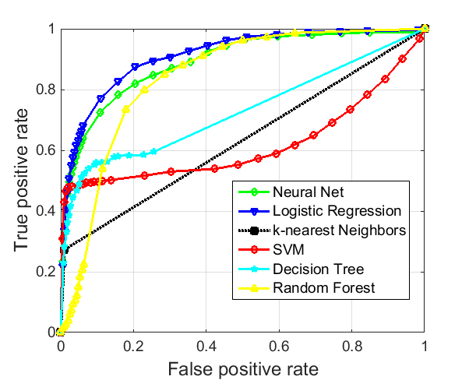
Learning from the Data
Positives: complaining users
Negatives: no complains in a given hour
50% training, 50% test
LR is simple yet yields best result
Notes:
The dataset contains 1275 positives, a user is considered a positive if the user makes a complaining phonecall in the hour. We have a lot more negative users, these are the users who do not make a complaint during an hour. We used 50% for training and 50% for testing. We throw the data into the usual suspect machine learning algorithms, basically the most well known ones. In this particular case, LR shows the best result. The figure shows the result, the x-axis is the false positive and y-axis true positive. So ideally, we want the curve to be at the left upper corner. Of course, we all know that is not possible.
AUC (Area Under the Curve)

Slide 59
Baseline Approach
Given the learned model, predict positive users on the fly
Evenly allocate (additional) resource to positives
Information lost in resource allocation
Users
w/ metrics
Initial Training Data
User w/
labels
Classifier Construction
Learned Classifier
Resource
Allocation
Notes:
The baseline approach is how one can use the classifier or the prediction directly. Basically, one can learn the classifer offline as in this box. When new users come in, we apply the learned classifer to the users in an online fashion, and decide if the user is positive or negative. Then we can evenly distribute resource to the predicted positives.

Slide 60
Proposed Approach
Not only the prediction result, but also the model itself, to guide resource allocation
Best estimate of the quantitative relationship
Notes:
Our main innovation in this work is the following idea. Instead of just using the prediction result itself, we should also more explicitly use the model itself. The rational is that the model itself contains a lot of information, as it is the best estimate of the quantivative relationship between the user performance metrics and user experience. Let me be a little bit more specific.

Slide 61
Learning-Model-Guided Resource Allocation
Learning (offline)
Labeled samples,
Resource allocation (online)
M runtime instances,
Feature vector
Label
→
Resource
Updated feature
Notes:
The first step is the offline learning step. Specicially, we have a set of labeled samples, x_i is the feature vectors, in other words, the network performance indicators I showed you earlier. The label is 1 if a postive and 0 if negative. We feed this dataset into the taining model, btw, this is the standard ML classification stuff. The output of the learning model is a best fit classier with its weight.

Slide 62
Notes
Not all feature values can be affected by resource allocation.
Ex: device features, content provider
Not all problems can be solved by the network.
Learned models show correlation not causation
Domain knowledge
Experiments
No worse than abstract utility function-based resource allocation
Is the model still valid after resource allocation?
Notes:
Correlation instead of causation, however, it is worth mentioning that this is no worse than tradtional abstract utility function approach, wehre we basically assume a caustaion relationship
Another question is of course, even if the model is valid as is, is it still valid after resource allocation, after all, we manipulate and thus change the distribution.
These two issues, causality and validity, bring us to the third component in the framework.

Slide 63
Proposed Approach
Validate, invalidate, and adjust the model based on feedback

Slide 64
Data-Guided Resource Allocation
Input: trained classifier, users w/o label, available resources
Output: users w/ updated features

Slide 65
A Closer Look at LR
Learn a logistic regression model
Positive probability
Negative probability
Notes:
And its associated weights. The training model of the LR maximazes the conditional likeholld (i.e., the product of all conditional probabilities)

Slide 66
Model-based Resource Allocation
Two types of resources:
Additional bandwidth -> improve throughput
Active reconnection -> reduce connection failures
Linear effects of resource allocation on features
(P-0)
User diff., known
Available resource
User-side resource
constraints

Slide 67
Algorithms
To solve multi-resource case
Non-convex optimization

Slide 68
Separable Problems with Linear Constraints
Considering a separable nonconvex function:
Ref: Bounding Duality Gap for Separable Problems with Linear Constraints,
M. Udell, S. Boyd, Computational Optimization and Applications, 2016.

Slide 69
DualHet Algorithm
Resource cost
Update cost
Individual user actions
Cause of the duality gap
Notes:
The gap between the DualHet algorithm and the optimum is bounded by the types of resources.
Heterogeneity is used to prove that no more than K users have multiple solutions given the optimal Lagrangian multiplier.
KKT conditions are used to get optimal solution given Lagrangian multipliers for individuals. It can find the optimal solution when the learned model is logistic regression.

Slide 70
Performance Evaluation
How effective is the resource allocation?
Baseline
Predict positives based on the same model
Allocate resource evenly to the predicted positives
Optimized by selecting the best decision threshold
Notes:
Synthetic dataset has ground truth

Slide 71
Synthetic Dataset
2D Gaussian distributed
Allocating resource increases only
Before & after resource allocation
 | mean | covariance
Positive | (-10, -10) | [8, 0; 0, 8]
negative | (10, 10) | [8, 0; 0, 8]
Notes:
Homogeneous weights

Slide 72
Cellular QoE Dataset
Two types of resources
Bandwidth
Increase feature 11 (ThroughputD/TrafficD)
Active reconnection
Decrease feature 9 (RadioFail)
Logistic regression

Slide 73
Cellular QoE Dataset
Reduces up to 2x complaints compared with the optimized baseline.
Achieves greater improvement when the resource is scarce.
Ours
baseline
Notes:
Show the effectiveness of the idea (using model to guide resource allocation)

Slide 74
Cellular QoE Dataset
Close to the optimal solution.
The performance loss with respect to the upper bound is less than 3%.
upper bounds
ratio
Notes:
We note that the upper bound may or may not be achievable. Effectiveness of our algorithm design.

Slide 75
Close the Loop
Validate, invalidate, and adjust the model
We were not able to complete this step for this work.
Notes:
The evaluation component serves two critical roles:
The first one is to validate and invalidate the model. Specifically,

Slide 76
Exploration
Exploration space is tremendous
Perturbation-based approach
How to integrate domain knowledge and utility-model-based approach?
Domain knowledge or utility-model based results could also be significantly suboptimal

Slide 77
Discussion
Data
Collection
Granularity
Experimentation
Methodology
Learn a utility model and optimize over the learned model
A general reinforcement learning approach

Slide 78
Network Configuration
Ongoing work

Slide 79
Cellular Network Configuration

Slide 80
Challenges
High dimensionality
Large # of parameters
User variability
Interference
Highly noisy data
Abundant data but may not be what we need
Experiment is very difficult

Slide 81
Pilot Power Configuration
The impact of pilot power
Coverage area
Transmission power

Slide 82
Challenges
Limited data availability
Current network config. does not change often
Convoluted sample data
(time, pilot power, throughput, # of users)
Interference among cells
Coupled optimization
Time-varying network dynamics
Need for adaptive algorithms
Large # of control parameters

Slide 83
Approach 1: Prediction-model-based Optimization
Neural-Network-based Prediction:
Aggregate data from different cells
Estimate hidden environmental parameters that do not depend on action
Build a neural-network model to predict throughput
Notes:
~0.70 cross validation accuracy

Slide 84
Gibbs-sampling-based optimization
Use the learned model as a utility function for pilot power optimization
Gibbs-sampling method
Addresses local coupling issue
Optimality (under technical constraints)
Online fast convergence algorithms

Slide 85
Overall Performance

Slide 86
Approach 2: Kernel-Based Contextual Bandits
Given a network state, decide the cell tower configuration
Contextual bandit
Cells are similar, but not identical
Multi-task learning
Kernel-based method to quantify similarity and to transfer knowledge

Slide 87
Performance of Multi-task Learning

Slide 88
Summary
Data-driven cellular configuration
Joint learning and optimization framework
Applicable to other network configuration problems
Limited data availability
High control dimensionality

Slide 89
Opportunistic Bandits
Huasen Wu, Xueying Guo, Xin Liu
Computer Science Department
University of California, Davis
ICML 2018

Slide 90

Multi-Armed Bandits
Classic MAB
Exploration-exploitation tradeoff:
Exploration: pull different arms to collect information
Exploitation: pull the best arm so far
…
Notes:
In earlier talk, Cong has introduced MAB. The key of MAB problems is to balance the exploration-exploitation tradeoff. In particular, exploration is to try different arms to collect information. Exploitation is to pull the best arm so far. For example, you want to go out for dinner tonight. Trying a new restaurant is exploration, you may love it, you may hate it. It is also somewhat random, depending on what you order and the service you get. On the other hand, you have been here a few days, or a few years. You know someplace that you will like. Going to your current favorite is exploitation.
The tradeoff between exploration and exploitation is fundamental to all learning problems, including RL and deep RL. In this talk, we focus on the class MAB.
, In existing studies of multi-armed bandits, a key assumption is that pulling a suboptimal arm results in a constant regret. While this is a valid assumption in many existing applications, there exists a variety of applications where the actual regret of pulling a suboptimal arm may vary depending on external conditions.

Slide 91

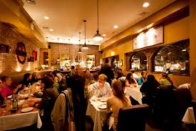

Multi-Armed Bandits
Notes:
Putting in a real-life example, you are visiting a place, you might have been here a few days or a few years. You decide to go out and eat. Which restaurant you go is a MAB problem.
In existing studies of multi-armed bandits, a key assumption is that pulling a suboptimal arm results in a constant regret. While this is a valid assumption in many existing applications, there exists a variety of applications where the actual regret of pulling a suboptimal arm may vary depending on external conditions.

Slide 92
Load Variation
Network configuration problem
Best configuration under peak load
Traffic dynamics
Traffic-dependent regret of a suboptimal arm.
Notes:
So what motivates us to study the so-called “opportunistic bandit”? Let’s consider the first application scenarios. First, consider networks.
Network configuration is widely used in wireless networks, data-center networks,
and the Internet, in order to control network topology,
routing, load balancing, and thus improve the overall performance.
For example, in a cellular network, a cell tower has
a number of parameters to configure, including radio spectrum,
transmission power, antenna angle and direction, etc.
The configuration of such parameters can greatly impact the
overall performance, e.g., coverage, throughput, and service
quality. A network configuration can be considered as an
arm, where its performance needs to be learned. Networks
are typically designed and configured to handle the peak
load, and thus we hope to learn the best configuration for
the peak load. This can be considered as a bandit problem, basically trying different arms, i.e., configurations, to find the best one.
Network traffic load fluctuates over time. This figure shows the network traffic of a real cell over a week. When the network load is low, we can inject dummy traffic into the network so that the total load, the real load plus the dummy load, resembles the peak load. It allows us to learn the performance of the configuration under the peak load. At the same time, the regret of using a suboptimal configuration is low because the real load affected is low. Furthermore, in practice, we can set the priority of the dummy traffic to be lower than that of the real traffic. Because networks handle high priority traffic first, low priority traffic results in little or no impact on the high priority traffic. In this case, the regret on the actual load is further reduced, or even negligible (when the suboptimal configuration is sufficient to handle the real load).

Slide 93
Price Variation
Bandits widely used for selecting best treatment
Produce price varies over time
Pork price – US cents per Pound (5/2012-11/2016)
Notes:
MAB has been widely used in studying effective procedures and treatments including in agriculture. In this scenario, different treatments can be considered as arms. The effectiveness of a particular treatment is captured by the value of the arm.
At the same, In agriculture, price often varies significantly for produce and livestock. For example, the figure shows that the pork price varied from \$0.46/lb to \$1.28/lb, in 2014-2017 (Index Mundi). The monetary reward is proportional to price and to the effectiveness of the treatment, which are independent factors. The goal of a producer is to minimize the overall monetary regret, compared to the oracle. Therefore, intuitively, when the product price is low, the monetary regret of pulling a suboptimal arm is low, and vice versa.

Slide 94
Restaurants
Notes:
Now, let’s consider again the restaurant example. Let’s say you are taking your date to dinner. Which one should you go? I do not know about you. But for most people, that will depend on the occation. So for example, it is really important, or a special occation, I may not want to explore and take the risk of a bad restaurant. That basically means that there exists an external factor, which is independent of the restaurants themselves, that affect my “regret”. That is what we called opportuistic bandit. Let me define it formally next.
if I am taking my date, who happens to be my date for the past 20+ years. Well, we have survived more than bad dinners. Still, there are occasions, like a birthday, that I do not want to risk a bad restaurant.

Slide 95
Opportunistic Bandit
The best arm remains the same
Best configuration under peak load
Best treatment
Best restaurant
The regret of a suboptimal arm varies depending on an external factor
Traffic load
Price/cost
Occasion
This external factor is known before the decision
Notes:
The name is inspired by “opportunistic scheduling”, an idea in wireless communication networks.
otivated by these application scenarios, we study opportunistic bandits in this paper. Specifically, we define {\em opportunistic bandit} as a bandit problem with the following characteristics: 1) The best arm does not change over time. 2) The exploration cost (regret) of a suboptimal arm varies depending on a time-varying external condition that we refer to as \textbf{load} (which is the price in the first scenario). 3) The load is revealed before an arm is pulled, so that one can decide which arm to pull depending on the load. As its name suggests, in opportunistic bandits, one can leverage the opportunities of load variation to achieve a lower regret.
In addition to the previous two examples,
opportunistic bandit algorithms can be applied to other scenarios that share the above characteristics.

Slide 96
Comparison
Non-stationary bandits
Contextual bandits
Notes:
Note that opportunistic bandits significantly differs from non-stationary bandits. In non-stationary bandits, the expected reward of each arm varies and the optimal arm may change over time, e.g., because of the shift of interests. In opportunistic bandits, the optimal arm does not change over time, but the regret of trying a suboptimal arm changes depending on the load. In other words, in non-stationary bandits, the dynamics of the optimal arm make finding the optimal arm more challenging. In contrast, in opportunistic bandits, the time-varying nature of the load provides opportunities to reduce the regret of finding the fixed optimal arm. Because of such fundamental differences,
in non-stationary bandits, one can show much worse regret compared to standard MAB polynomial regret (e.g., $\Omega(T^{2/3})$ \cite{Besbes2014NIPS}) because one has to keep track of the optimal arm. In opportunistic bandits, we can show $O(\log T)$ (or even $O(1)$ in certain special cases) regret because we can push more exploration to slots when the regret is lower.
We also note the connection and difference between opportunistic bandits and contextual bandits \cite{Zhou2015CMAB:Survey,Wu2015NIPS:CCB}. Broadly speaking, opportunistic bandits can be considered as a special case of contextual bandits where we can consider the load as the context. However, applying existing general contextual bandits algorithms will not generate optimal regrets because they do not take advantages of the unique properties of opportunistic bandits, in particular, the optimal bandit remains the same, and regrets differ under different contexts (i.e., load).
To the best of our knowledge, this is the first work proposing and studying opportunistic bandits that aims to adaptively balance the exploration-exploitation tradeoff considering load-dependent regrets.

Slide 97
System Model
MAB with K arms
X_{k,t} : nominal reward of the k-th arm at time t
i.i.d over time
u* : best expected nominal reward
L_{t}: external factor, called load
Observed before making the decision at time t

Slide 98
Problem Formulation
Based on history data and current load, decide which arm to pull
Actual reward L_{t}X_{k,t}
Actual expected regret L_{t}[u*-E(X_{k,t})], given L_{t}
Minimize the overall actual regret:
Application scenarios
Notes:
This model captures the essence of opportunistic bandits. The assumptions here are: its assumptions are reasonable.
% The two assumptions ($X_{k,t}$ is independent of $L_t$ and the value of $X_{k,t}$ is observable) are reasonable.
For example,
in the agriculture scenario, $X_{a_t, t}$ captures the effectiveness of a treatment, e.g., the survival rate or the yield of an antibiotic treatment. The value of $X_{a_t, t}$ can always be observed by the agent after applying treatment $a_t$ at time $t$. Conditioned on $a_t$, $X_{a_t, t}$ is also independent of $L_t$, the price of the commodity. Meanwhile, the actual reward, i.e., the monetary reward, is modulated by $L_t$ (the price) as $L_t X_{a_t, t}$.
In the network configuration example, $X_{a_t, t}$ captures the impact of a configuration at the peak load, e.g., success rate, throughput, or service quality score. Because the total load (the real load plus the dummy load) resembles the peak load, $X_{a_t,t}$ is independent of the real load $L_t$ conditioned on $a_t$, and can always be observed. Further, because the real load is a portion of the total load and the network can identify real traffic from dummy traffic, the actual reward is thus a portion of the total reward, modulated by the real load as $L_t X_{a_t, t}$.

Slide 99
Problem Formulation
Based on history data and current load, decide which arm to pull
Actual reward L_{t}X_{k,t}
Actual expected regret L_{t}[u*-E(X_{k,t})]
Minimizing the overall actual regret:
Intuition: Explore more when the load is low;
exploit more when the load is high
Notes:
This model captures the essence of opportunistic bandits. The assumptions here are: its assumptions are reasonable.
% The two assumptions ($X_{k,t}$ is independent of $L_t$ and the value of $X_{k,t}$ is observable) are reasonable.
For example,
in the agriculture scenario, $X_{a_t, t}$ captures the effectiveness of a treatment, e.g., the survival rate or the yield of an antibiotic treatment. The value of $X_{a_t, t}$ can always be observed by the agent after applying treatment $a_t$ at time $t$. Conditioned on $a_t$, $X_{a_t, t}$ is also independent of $L_t$, the price of the commodity. Meanwhile, the actual reward, i.e., the monetary reward, is modulated by $L_t$ (the price) as $L_t X_{a_t, t}$.
In the network configuration example, $X_{a_t, t}$ captures the impact of a configuration at the peak load, e.g., success rate, throughput, or service quality score. Because the total load (the real load plus the dummy load) resembles the peak load, $X_{a_t,t}$ is independent of the real load $L_t$ conditioned on $a_t$, and can always be observed. Further, because the real load is a portion of the total load and the network can identify real traffic from dummy traffic, the actual reward is thus a portion of the total reward, modulated by the real load as $L_t X_{a_t, t}$.

Slide 100
Problem Formulation
Based on history data and current load, decide which arm to pull
Actual reward L_{t}X_{k,t}
Actual expected regret L_{t}[u*-E(X_{k,t})]
Minimizing the overall actual regret:
Challenges: balance exploration-exploitation
Performance analysis and guarantees
Notes:
The design challenge is to balance … under load variation.
The analytical challenge is to analyze the performance of the proposed algorithm.

Slide 101
Classic UCB
In each time slot t, calculate index for each arm:
Pull the arm with the largest index
Notes:
Before we discuss the opportunistic bandit algorithm, let me quickly review the classic UCB algorithm so that everyone is on the same page.

Slide 102
AdaUCB
AdaUCB: Adaptive Upper Confidence Bound algorithm
In each time slot t, calculate index for each arm based on load:
Pull the arm with the largest index
Notes:
Note that here L_t tulta is the normalized load. It varies from 0 to 1. If you look at it, the intuition is clear, we explore more when the load is low. For example, when the load is zero, it is basically the classic UCB. When the load is 1, it becomes pure exploitation.
Note that we have tried many different format of load-awareness. This performs well in a wide range of experiments, as well as allows theoretical analysis. We we adopt it here.

Slide 103
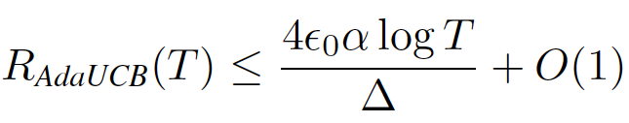
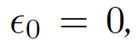
Theoretical Result
Theorem 1: Using AdaUCB in opportunistic bandits with random binary-valued load and random rewards, we have
AdaUCB can achieve lower regret than UCB when the load fluctuation is large.
When O(1) regret.
Notes:
While the AdaUCB algorithm itsslef is simple, the analysis is highly involved. The design challenge is to quantify the right amount of exploration and exploitation depending on the load. The analysis challenge is due to the inherent coupling over time and thus over bandits under different load conditions, this is in particularly difficult under continuous load. In particular, due to the randomness nature of bandits, the empirical estimates of the expected rewards could deviate from the true values, which could lead to suboptimal actions when the load is high. We address these challenges by studying the lower bounds on the number of pulls of the suboptimal arms under low load. Because the exploration factor is smaller under high load than that under low load, it requires less information accuracy to make the optimal decision under high load. Thus, with an appropriate lower bound on the number of pulls of the suboptimal arms under low load, we can show that the information obtained from the exploration under the low load is sufficient for accurate decisions under the high load. As a result, the exploration under high load
is reduced and thus so does the overall regret.
In this bound, \epsilon_0 is the value of low load and alpha is a constant used in the algrithm.
In addition, we can show that when the low load is small enough, we can prove that the regret of AdaUCB is smaller than that of UCB. Most interestingly, when the low load is zero, we can prove O(1) regret, which is surprising. And to the best of our knowledge, the first such O(1) result. We also note that \epsilon_0=0 is not purely theoretical, it happens. For example, in the network configuratino case, because we put the injected “dummy” traffic as low priority, all real traffic might be well served by the suboptimal config. So there is no real cost, which is equivalent to load=0. So we basically get free exploration opportunities.

Slide 104
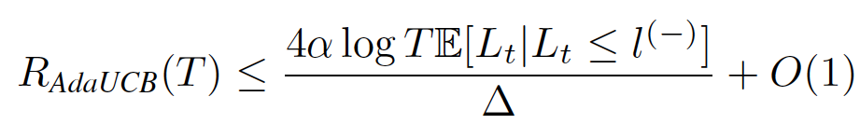
Theoretical Result
Theorem 2: Using AdaUCB in opportunistic bandits with random continuous load and random rewards, we have
AdaUCB can achieve lower regret than UCB when the load fluctuation is large.
Load-awareness is proven beneficial.
Notes:
We further prove the case for the continuous load case. Here in the bound, l(-) is a threshold that under which, we consider it low load. This result is for the special case when the load is less than l(-), we consider the normalized load 0, and when the load is larger than l(+), we consider the normalized load 1. Because in more general cases of l(-) and l(+), the analysis is extremely challenging as there are also explorations in between.
Again, we can see that when the load fluctuation is large, This expected term small enough, AdaUCB achieves lower regret than UCB.
Therefore, we prove theoretically that load-awareness is beneficial.

Slide 105
Simulation Results
0-1 load (O(1) regret)
Beta distributed load
Synthetic data simulation under discrete and continuous load
Notes:
0-1 load, 50% of zero load.
Beta distribution load: l^- =0.05, l^+=0.05. E-adaUCB is the empirical AdaUCB algorithm where we do not know the distribution a priori and needs to learn it. It performs closely to that of AdaUCB where we assume the load distribution is known a priori.

Slide 106
Real Trace Evaluation
Virtual Mobile Network Operation
Non-stationary
Non i.i.d.
Notes:
Last, we show the result of AdaUCB using real-world traces. In an MVNO (Mobile Virtual Network Operator) system,
a virtual operator, such as Google Fi (Project Fi, https://fi.google.com), provides services to users by leasing
network resources from real mobile operators. In such a system, the virtual operator would like to provide its users high
quality service by accessing the network resources of the real operator with the best network performance. Therefore,
we view each real mobile operator as an arm, and the quality of user experienced on that operator network as the reward.
We use experiment data from Speedometer (Speedometer, https://storage.cloud.google.com/speedometer) and another
anonymous operator to conduct the evaluation. The most important aspect of the real trace evalution is that the data is non-stationary and non i.i.d. which violates all assumptions we have made in the analysis. The results still show superior performance in realistic situations.

Slide 107
Conclusions and Future Work
Identify and study opportunistic bandit
Regret depends on time-varying external conditions
AdaUCB: balancing exploration-exploitation tradeoff according to the load
Theoretically demonstrate the benefit of load-awareness
Inspired by network traffic dynamics
Applicable to other applications
More general exploration-exploitation scenarios
Notes:
To the best of our knowledge, this is the first work that identifies and studying opportunistic bandit. We propose the AdaUCB algorithm that opportunistically balance the exploration-exploitation tradeoff. We show strong theoretical results. To the best of our knowledge, this is the first work with O(1) regret.
The idea is applicable other scenarios with exploration-exploitation tradeoffs.

Slide 108
Contextual Bandits with Budget and Time Constraints
The Twenty-ninth Annual Conference on Neural Information Processing Systems (NIPS)
The Twenty-ninth Annual Conference on Neural Information Processing Systems (NIPS)
The Twenty-ninth Annual Conference on Neural Information Processing Systems (NIPS)
Joint work with
Huasen Wu, R. Srikant, and Chong Jiang
NIPS 2015
Notes:
Good afternoon/morning, …
Today I would like to present our work on “Contextual bandits with budget and time constraints”
This is a joint work with …
This paper has been accepted by NIPS’15, the full version of this paper can be downloaded from arxiv

Slide 109


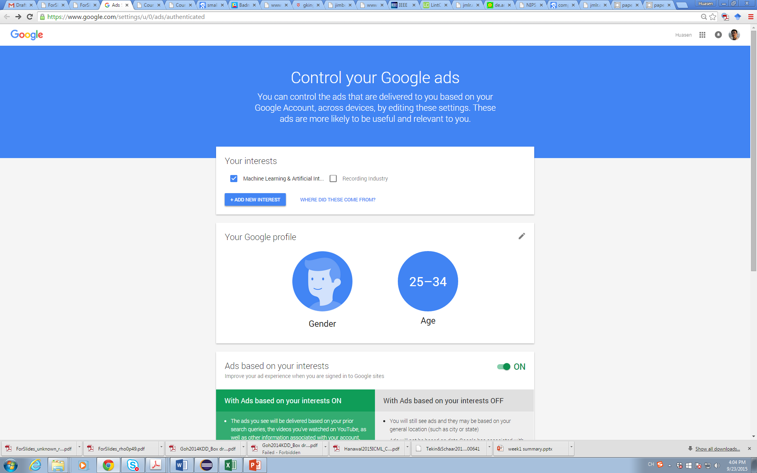
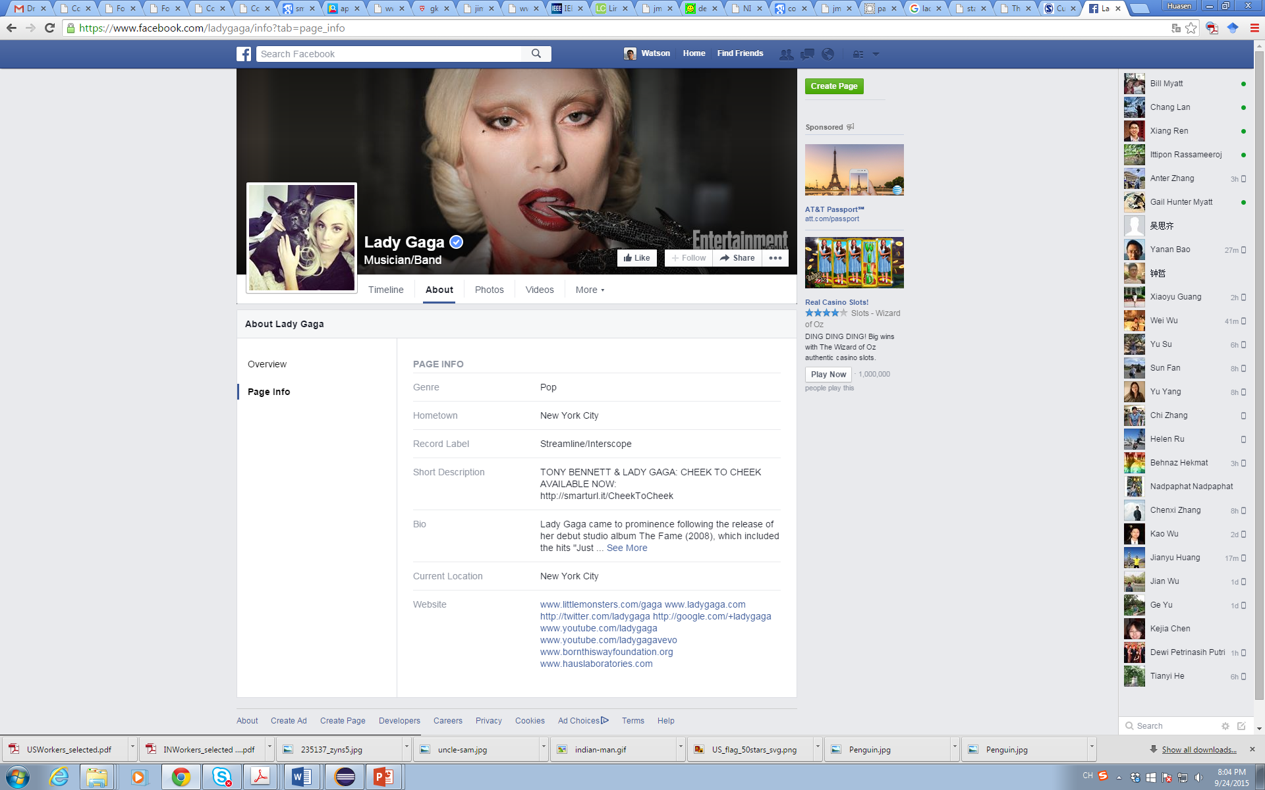
Contextual Bandits
Context: side information
Gender, age, occupation, etc.
Most systems have side information
Notes:
In practice, much side information can be utilized to help decision.
For example, Google has maintained the profile of users, such as gender, age, occupation.
For example, I am just a postdoc working on some staff, but this lady is so fashion and probably can afford much more than me.
With this side information, the system can execute targeting ads.

Slide 110
Constrained Contextual Bandits
Action incurs cost
Depending on context and action
Contextual Bandits with
Horizon T
Budget B
Objective
Maximize total reward U_{Γ}(T) = E[Y₁+Y₂+ … +Y_{T}]
Subject to budget constraint: Z₁+Z₂+ … +Z_{T} ≤ B
Regret: R_{Γ} (T) = U*(T) – U_{Γ}(T)
Asymptotic regime: T → ∞, with B/T = ρ fixed
Notes:
However, there not such thing as free lunch. Taking an action under a context consume some resource. For example, you need to pay for an ad or a worker.
But the resource is limited, therefore, we are interested in the contextual bandits with budget and time constraints.

Slide 111
An Example
A sequence of jobs to be allocated to crowd-workers of unknown quality
Context: iOS, Android, Cobol (Odesk)
Context: cleaning, cooking, gardening (TaskRabbit)
The quality of the job of a worker depends on the context
A limited budget to allocate a sequence of jobs.
Some jobs may not be allocated if its reward is not high enough wrt cost.
Maximize overall reward subject to budget
Learning under context and budget
An AMT experiment
Notes:
An example of such a constrained contextual bandits could be a crowd-sourcing. One has a set of jobs to be allocated to workers, such as house-cleaning cooking, pet-walking. Workers are typically paid at #20/hour. The quality of the work of a worker depends on the context. one has a limited set of budget to allocate a sequence of jobs. The goal is to maximize
A limited budget to allocate a sequence of jobs, some jobs may not be allocated …, That introduced coupling among time and across contexts.
We are running an experiemnt on AMT on this right now.

Slide 112
Conclusion
Order-optimal Algorithm for constrained contextual bandits
Approximation of the oracle
Algorithms with logarithmic regret: UCB-ALP
Learning
Decision
Context, Budget
Notes:
Key message: easily-implementable policies, achieve sublinear regret.
The results can be extended to heterogenous-cost systems.

Slide 113
Double Thompson Sampling for Dueling Bandits
Joint work with Huasen Wu
NIPS 2016

Slide 114

Dueling bandit
A variation of multi-armed bandit
Feedback in the form of comparison
Comparison might be easier, cheaper, and stable than absolute value evaluation
Notes:
Dueling bandit is a variation of the multi-armed bandit problem (A/B testing) that I discussed earlier. The difference is that the feedback comes in the form of comparisons. For example, if I ask an audience to rate his/her likeness of orange, that might be hard. However, if I ask someone which one he likes better, orange or apple, it might be easier. Using the A/B testing example again. The question is, say I have N webpage designs, I can ask my audience to compare a pair, and tell me which one he likes better. Of course, the feedback is noisy. I need to figure out the best webpage design as soon as possible.
Nonmetric multi-dimensional scaling

Slide 115
Double Thompson Sampling (DTS)
Thompson sampling
Bayesian-based learning algorithm
Simple, robust, good practical performance
DTS algorithm for dueling bandits
Simple yet w. proven performance guarantees
Significantly outperforms other algorithms in extensive simulations
Ref: Double Thompson Sampling for Dueling Bandits, NIPS 2016.
Notes:
The basic idea of Thompson Sampling (1933) is very simple: assuming certain prior distribution for the system parameters, the algorithm maintains the posterior distribution for these parameters and takes the best action according to samples drawn from the posterior distribution; the feedback of the system under the taken action is then used to update the posterior distribution. Empirical studies [11] show that this simple framework achieves performance similar to or better than other types of algorithms in practice.
As indicated by its name, D-TS selects both the first and the second candidates in the comparison pair according to Thompson Sampling. Specifically, D-TS maintains a posterior distribution for the preference matrix, and chooses the pair of arms for comparison by sampling twice from the posterior distribution. proven performance guarantees. Simulation results based on both synthetic and real-world data demonstrate the efficiency of the proposed D-TS algorithm.

Slide 116
Outline
Challenges and Opportunities
Case Studies
Application-driven studies
Theoretical studies
When and How

Slide 117
Characteristics of Good Problems
Law of large number
Understanding complex venue and large data
Large complex problem beyond white-box modeling
Heterogeneous environment with high optimality
Suitable data available/obtainable
Can evaluate proposed approaches
Existing solutions not satisfactory

Slide 118
Learning meets Networks
Optimality
Datacenters
(e.g., DCTCP)
High
Learning
Performance
Classical
Internet
(e.g., TCP)
Low
Homogenous
Heterogeneous
Universality
Environment
Acknowledgement: Mohammad Alizadeh, MIT

Slide 119
Typical Steps
Why learning is a suitable approach
Do not use ML for the purpose of using ML
Evaluate existing approaches and room for improvement
Problem abstraction and formulation
Model complexity, data availability, evaluation
Domain knowledge critical
Data collection and data cleaning
What, where, and how
ML algorithms
This is often the “easy” part
Iterate with data collection and evaluation
Evaluation
Interpretability and insights
Notes:
Problem abstraction and formulation can be important. In networks, the number of states can be extremely large is not carefully managed. This is a place where domain knowledge can be important. What are the important features, what are independent, what is the time granularity?
Consider the cellular QoE example (call complain). There are many different ways we could potentially formulate the problem: prediction-model + optimization, bandit algorithms, RL, deep RL. Data availability is a key factor. Learning complexity is another.

Slide 120
Pushing the Frontier of ML
New variants of existing machine learning problems
Valid and broad application scenarios
Deep learning and its deeper understanding
Deep reinforcement learning with higher dimensionality
Learning under constraints
Distributed learning

Slide 121
Who Cares?
Wide applications
Challenges
Advances

Slide 122
Challenges
Interpretability, Interpretability, Interpretability
Privacy
Security
Biases

Slide 123


